Slide 1
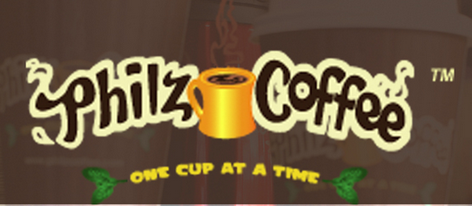
Philz Coffee Process Simulation
Team RedHat :
Anup Dudani
Meghana Gogi
Prabhu Maniraj
Sai Sudha Kiran Reddy Dwaram

Slide 2
Agenda
Introduction
Technologies used
Actors
Interactions
Demo

Slide 3
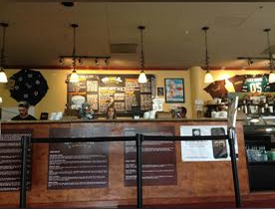
Introduction
Philz coffee real time scenarios have been considered to model our project simulation using Simpy.
Below are the scenarios: Service counter

Slide 4
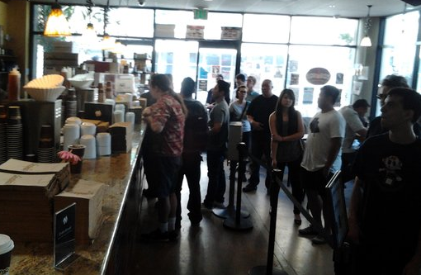
Customer Queue

Slide 5
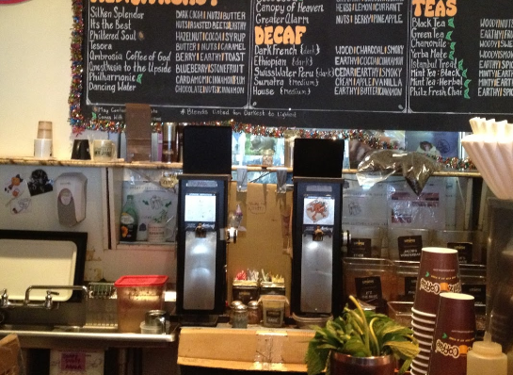
Coffee Bean Refilling

Slide 6
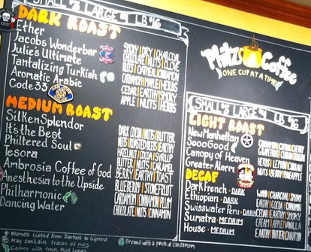
Type of Coffee

Slide 7
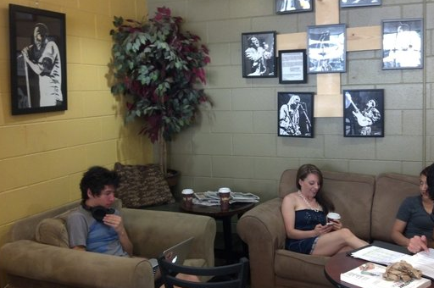
Waiting for Order

Slide 8
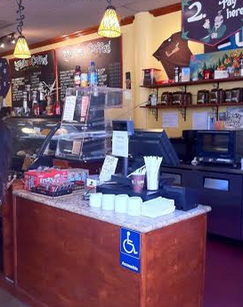
Check Out Counter

Slide 9
Technologies Used
Python
Simpy
ELK ( Elastic Search Logstash, kibana) : Total time in the coffee shop

Slide 10
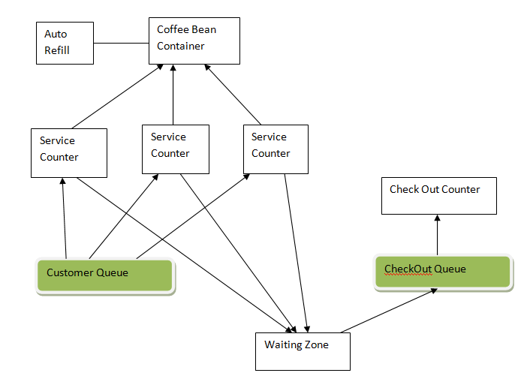
Architecture

Slide 11
Actors
Customer
Service counters
Checkout counter
Bean Container

Slide 12
Behaviors
Revoking (Patience time out)
Ordering
Refilling coffee beans
Checking out

Slide 13
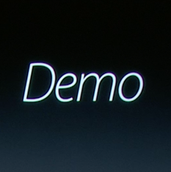

Slide 14


